Slide 1

FROM RENTALS TO STREAMING
Where to Go From Here
Keely Teh
January 2023

Slide 2
Objectives
Current Situation
Rockbuster Stealth once had movie rental stores from around the world. However, facing stiff competition from streaming services, such as Amazon Prime and Netflix, Rockbuster’s business has declined.
Objective
In order to stay competitive, Rockbuster plans to launch an online video rental service using its existing movie licenses.
Key Questions
Which movies contributed most and least to revenue gain?
What was the average rental duration for all videos?
Which countries are Rockbuster’s customers based in?
Where are customers based who have high lifetime value?
Do sales vary between geographic regions?

Slide 3

Rockbuster at a Glance
Number of Films
1,000
Customers
600
Average Rental Duration
5 days
Rental Rate
Minimum – $0.99
Maximum – $4.99
Average – $2.98
Total Sales in USD
$61,300

Slide 4
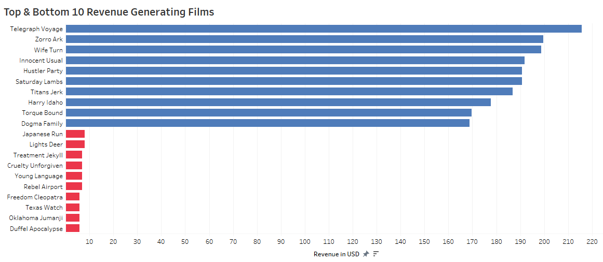
Sales by Film

Slide 5
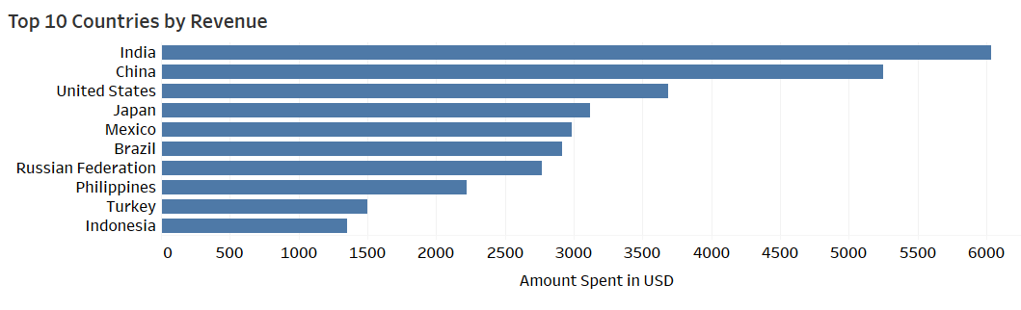
Sales Continued
Top 5 Countries by % of Total Revenue:
India
10%
China
10%
US
6%
Japan
6%
Mexico
6%

Slide 6
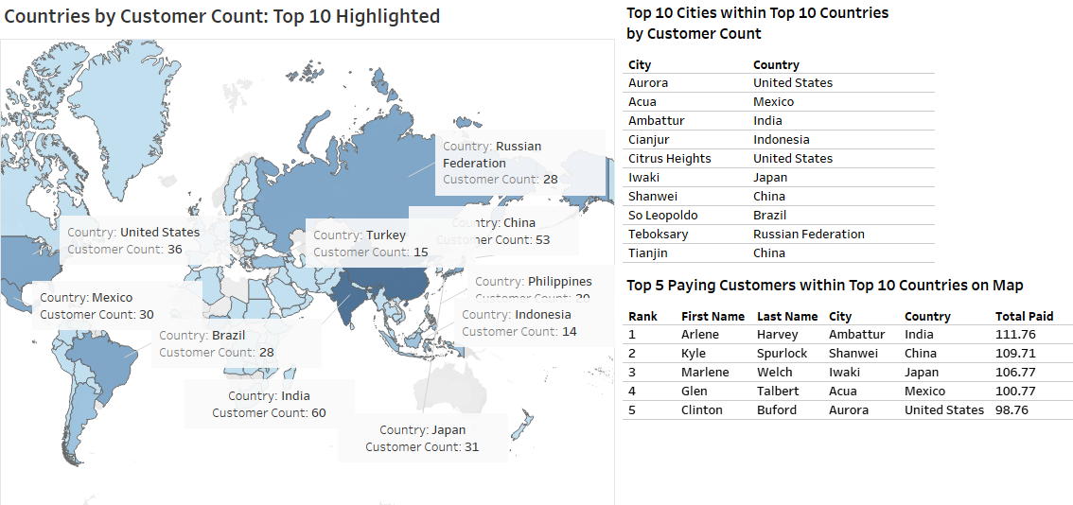
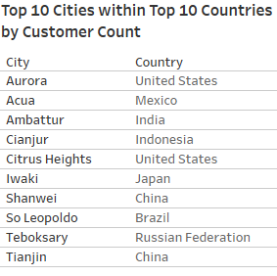
Customers

Slide 7
Next Steps
Rockbuster’s business is declining, but it already has customers that span across 109 countries, so it is a good time to expand into the market of online rentals and/or streaming.
For this new effort, the focus should begin on offering online rentals in the top 10 countries with the greatest sales as Rockbuster’s budget allows:
India, China, Japan, US, Mexico, Brazil, Russia, Philippines, Turkey, Indonesia.
Begin marketing efforts and reaching out to customers in the following countries (same list as above), as Rockbuster’s budget allows:
India, China, Japan, US, Mexico, Brazil, Russia, Philippines, Turkey, Indonesia.
Put more focus in populated cities, starting with top city by customer count in each of these countries.
Currently, the average price of Rockbuster’s rentals are around $3 and a 5-day rental duration. Compare this with the average streaming services and adjust the price competitively.
If this service is similar to Redbox, as in rental kiosks, the price must be somewhat lower than streaming rentals to compete with the convenience of streaming services.
Start with the highest revenue-generating films first, whatever the budget allows, whether this is the top 10, 100, or 500 movies. Also allow budget for the purchase of new releases.

Slide 8

Questions
Thank you!
Thank you for joining us!
Please send questions to analytics@Rockbuster.com, or call us at (555) 360-9000
Tableau Presentation: 3.10 SQL-Tableau Final Project | Tableau Public

